Slide 1

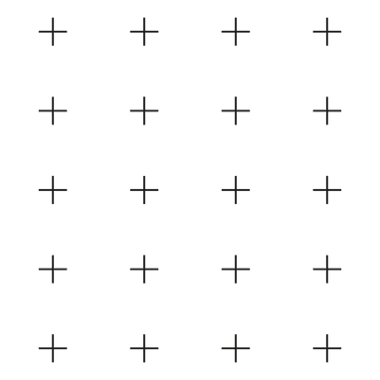



How the Web Works: From URL to Display
Sean Wong
2025/08/04

Slide 2
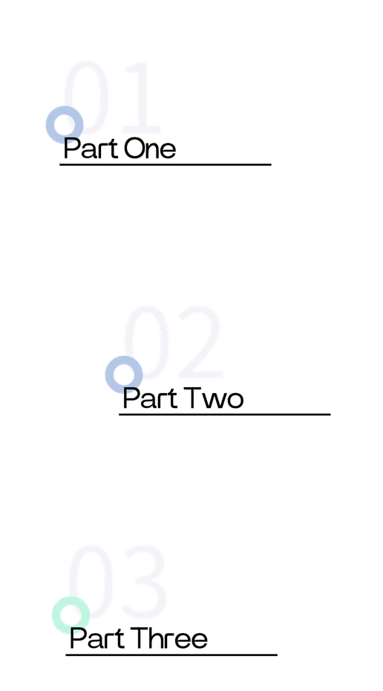

CONTENTS
Web Foundations
Core Technologies
Page Assembly

Slide 3

Web Foundations

Slide 4



Definition of the Web
Role of the Browser
URL Connection
The web is a global network of interconnected computers that share information through hyperlinks. It allows users to access and navigate through vast amounts of data stored on servers worldwide.
The browser acts as a client, requesting web pages from servers. It interprets HTML, CSS, and JavaScript to display content to users. Popular browsers include Chrome, Firefox, and Safari.
Typing a URL in the browser initiates a connection to the server hosting the requested page. The server responds with the web page data, which the browser then renders for the user.
The Web & the Browser

Slide 5

HTTP Request
The browser sends an HTTP request to the server for a specific resource, such as a web page. This request includes details like the URL, headers, and sometimes data.
HTTP Response and Status Codes
The server responds with an HTTP response containing the requested resource and a status code. Common codes include 200 for success and 404 for not found. HTTPS encrypts this communication for security.
The Request/Response Cycle

Slide 6
Core Technologies

Slide 7

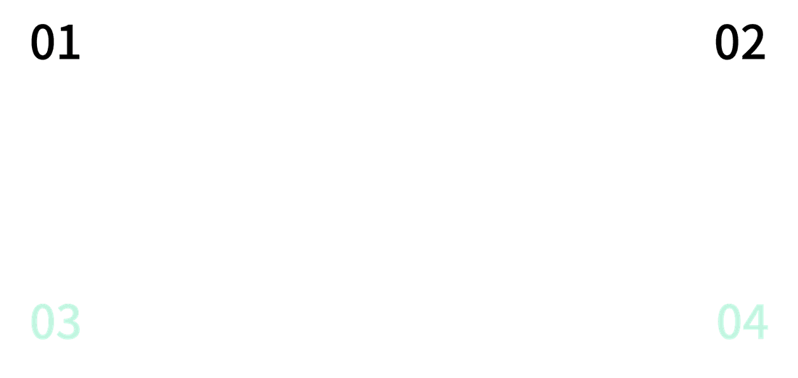
HTML: Structure of the Page
HTML Definition
Document Object Model
HTML (HyperText Markup Language) defines the structure and content of a web page using elements and tags. It provides the basic framework that browsers use to display content.
The Document Object Model (DOM) is a tree-like structure created by the browser from HTML. It represents the page's content and allows JavaScript to interact with it.
HTML Elements
Semantic HTML
HTML elements include headings (h1-h6), paragraphs (p), links (a), and images (img). These elements help organize and present content on the page.
Semantic HTML uses meaningful tags to describe content, improving accessibility and SEO. Examples include <header>, <footer>, <article>, and <section>.

Slide 8






CSS: Style & Presentation
CSS Overview
CSS (Cascading Style Sheets) controls the visual presentation of HTML content. It manages colors, fonts, spacing, and layout, enhancing the user experience and making web pages visually appealing.

Slide 9
Page Assembly

Slide 10

How a Page Loads
Resource Discovery and Requests
The browser parses the HTML and discovers additional resources like CSS, images, and JavaScript. It then sends separate HTTP requests for each of these resources.
Initial HTML Request
Rendering the Page
The browser first requests the HTML file from the server. This file contains the basic structure and content of the web page.
Once all resources are fetched, the browser assembles everything and renders the final page, displaying it to the user.

Slide 11

Summary: How the Web Works
Web Interaction Process
Core Technologies and Page Assembly
The web works through a series of interactions: the browser connects to a server via a URL, sends HTTP requests, and receives HTTP responses.
HTML provides structure, CSS adds style, and JavaScript enhances interactivity. The browser loads these components, assembles them, and renders the final page.

Slide 12



Sean Wong
2025/08/04

